Slide 1
Code Crafters
Software Engineering Group

Slide 2
Initial Discussion
Scrum Sprint on the JIRA board to track the progress on the assigned tasks.
Initial research in the progress on the connectors for the better understanding for developing the database related to the connectors.
Discussed the Limitations and the requirement to develop the software.
Brainstormed on the working plan and the methodology.

Slide 3
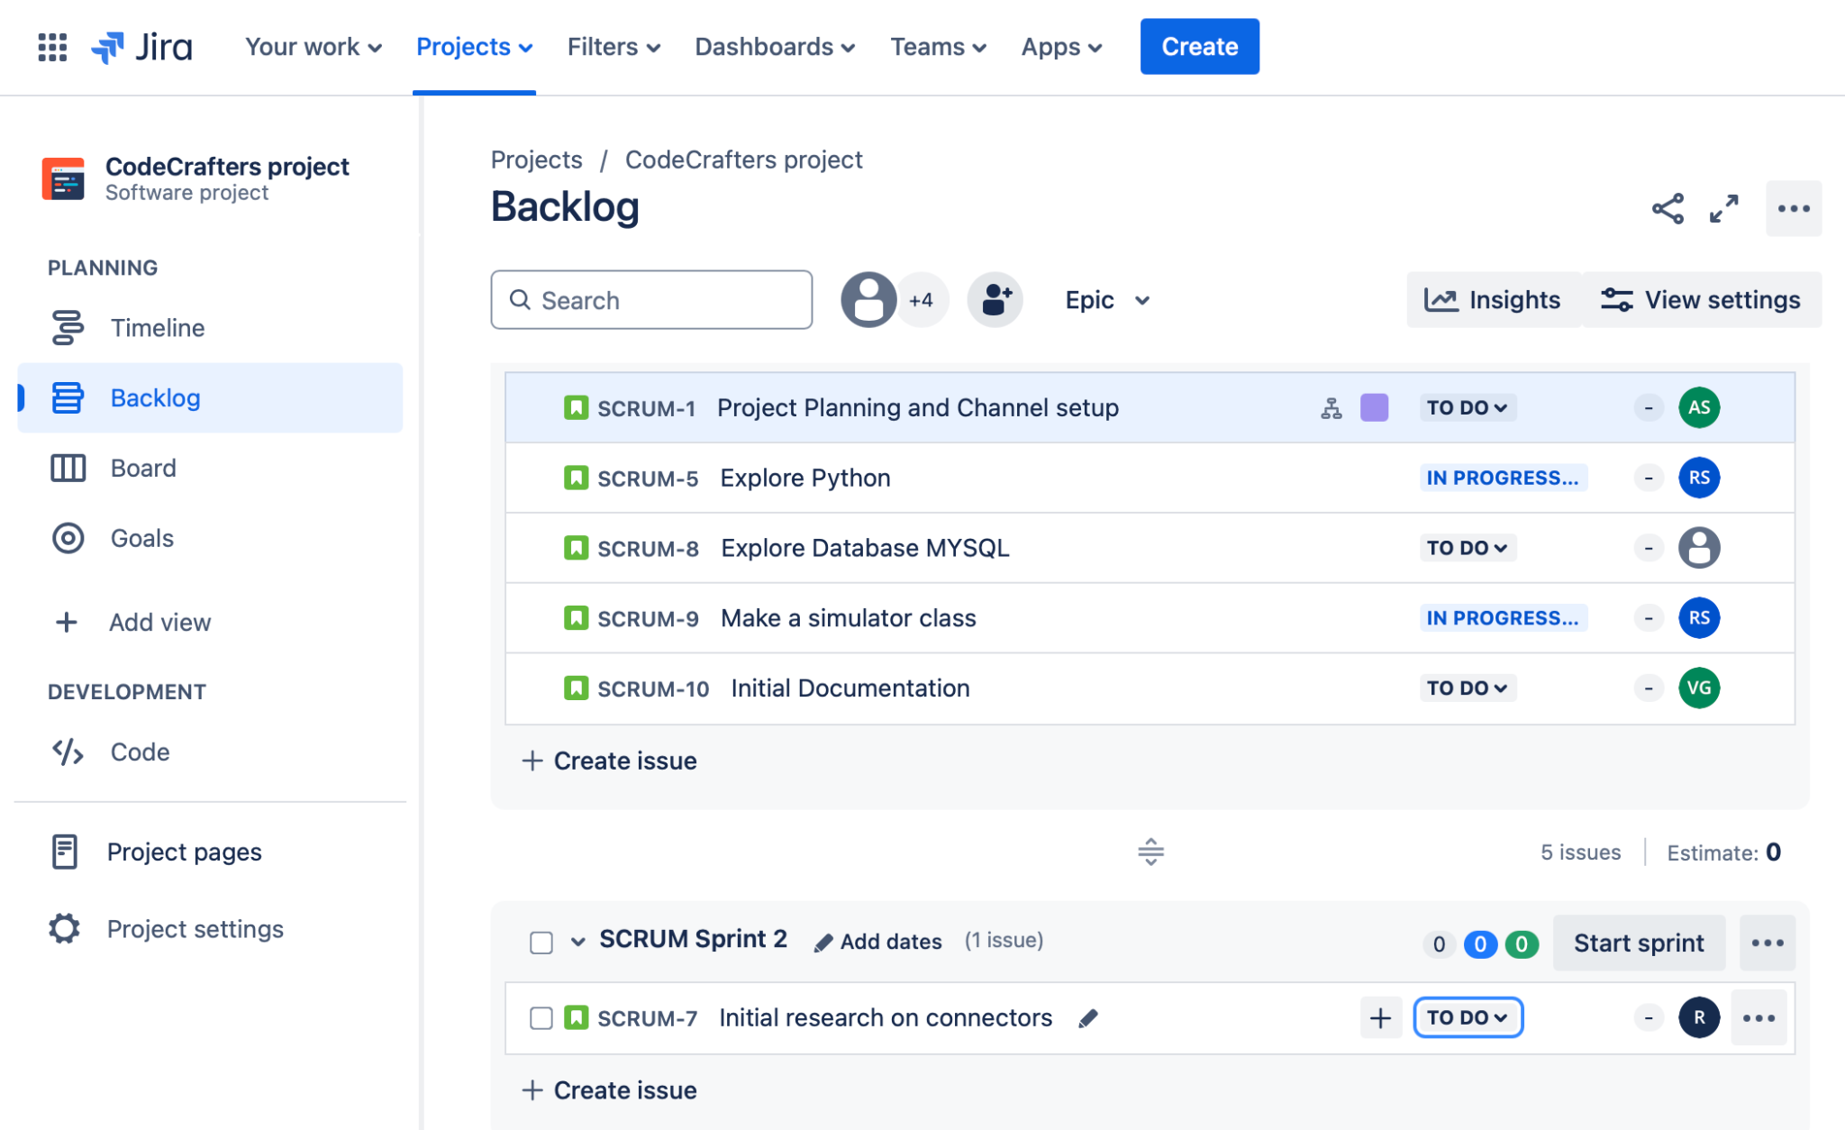
Progress…

Slide 4


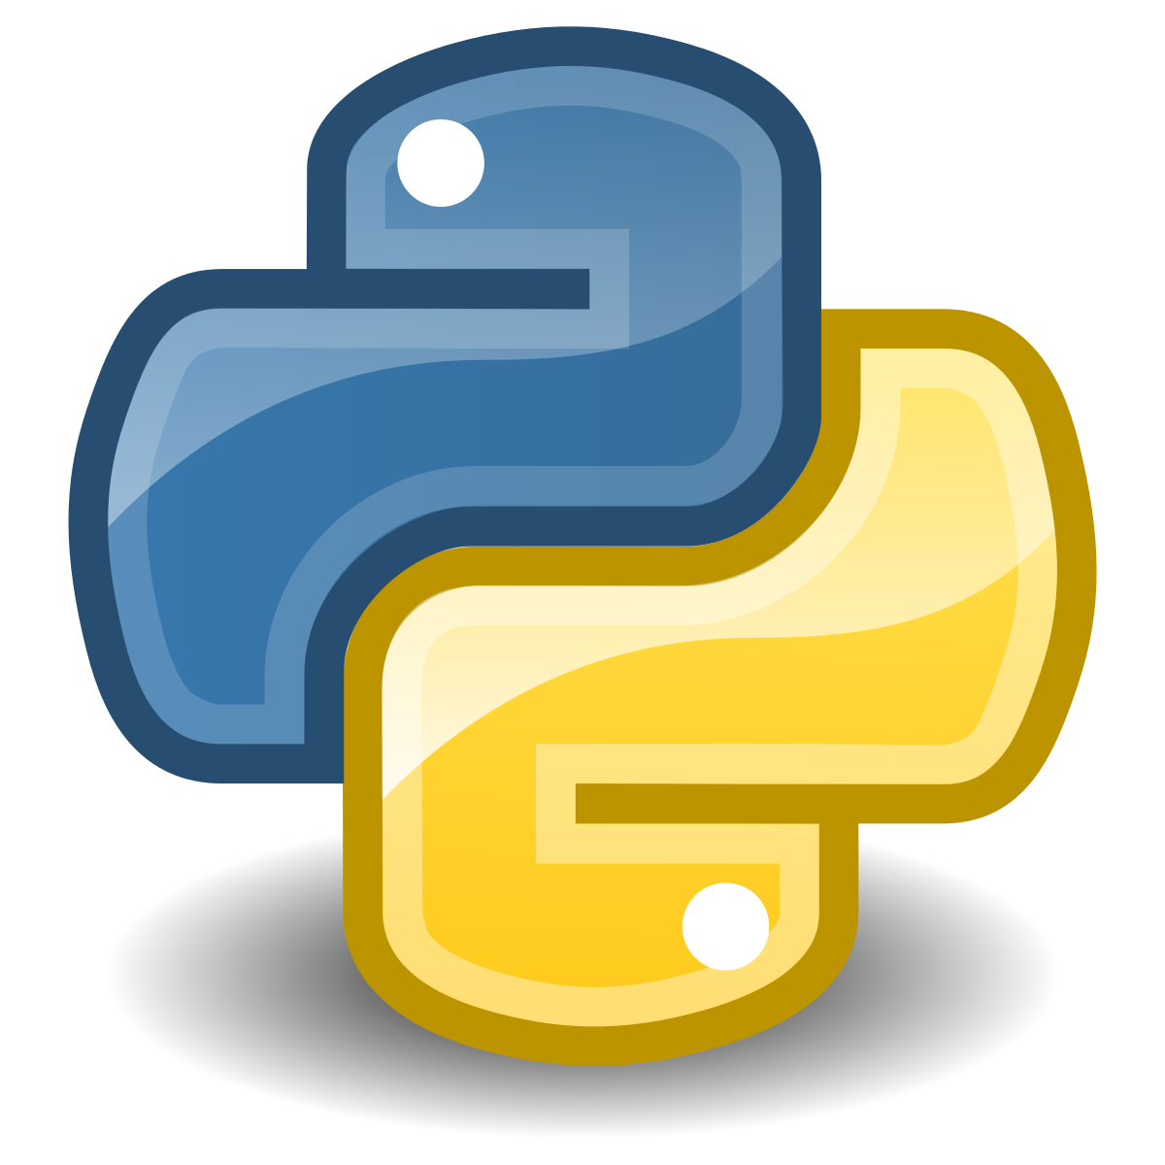
Focusing to learn and brushing up the Python skills to fulfill the system requirements.
Decided to work in the nexus with Code Sharing Platform i.e Github for easy accessibility.
Working on the software architecture and the algorithm to develop the system in accurate manner.
Felix will be used for the UI/UX to make the software user centric through intuitive navigation and the data visualisation.
DJANGO framework will be used for data scalability to make the application data driven and works on the python as well.

Slide 5
Working Plan
System Requirement
User experience
Code Sampling
Data Analysis,Testing

Slide 6
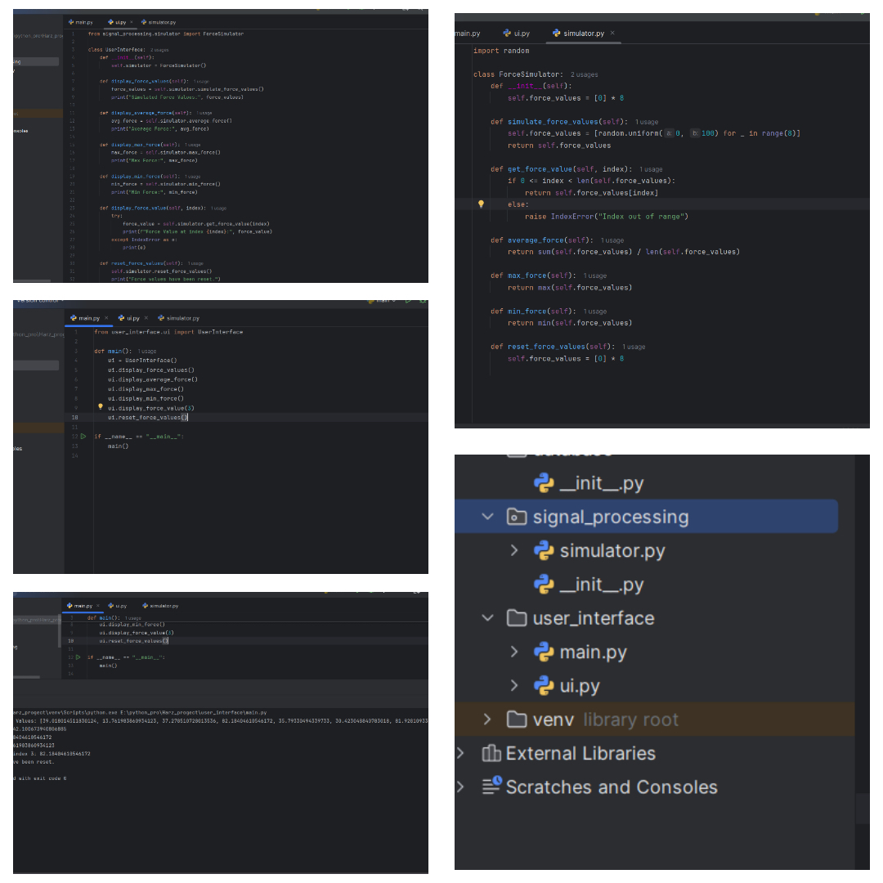
Sample Code on Python

Slide 7
Further Plan of Action
The main task is develop the GUI and API for the software for the better user experience using the Felix IT System Framework.
Improving simulation and their values for the better output along with the Electronics Team.
To develop the database for the data sampling and the data analysis.
Building up the structure of automation to get the outcome in an efficient manner.
Track the details and to collect the progress of the other teams through Project management Team.

Slide 8
Thank You!

